Slide 1

MLB Record Prediction
Michael Rodgers
SMGT 430
4/17/18

Slide 2
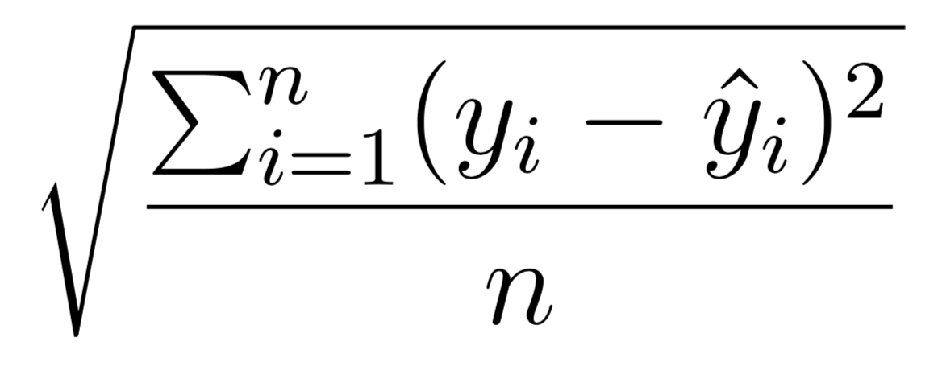
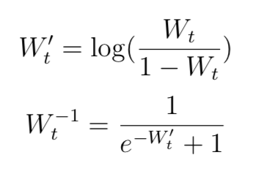
Methodology
Lahman Data
Seasonal Stats
Modeling Winning %
Transformation
MSPE
2005 – 2017
2018 Predictions
Convert W% to W-L
Notes:
We want the predictions to be within [0,1].

Slide 3
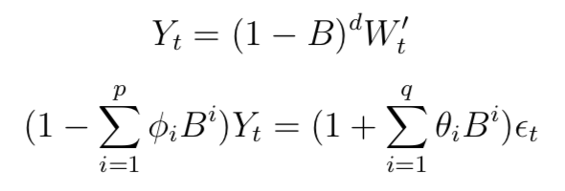
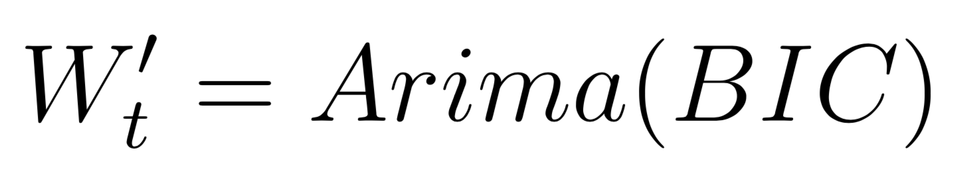
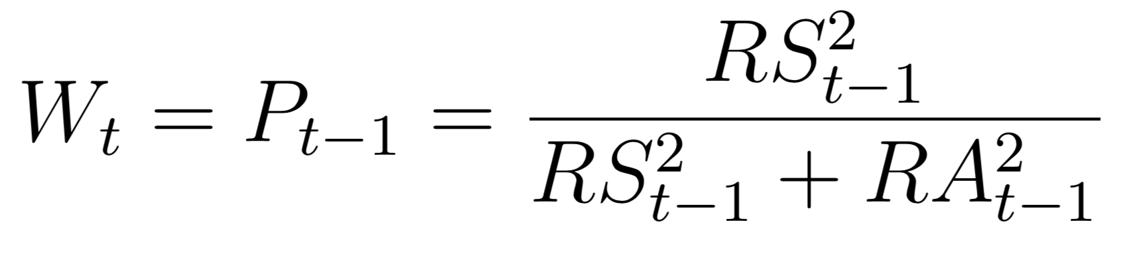
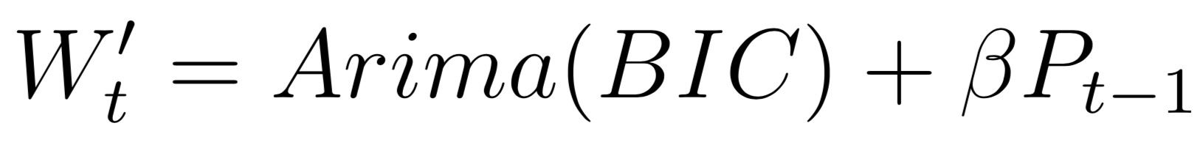
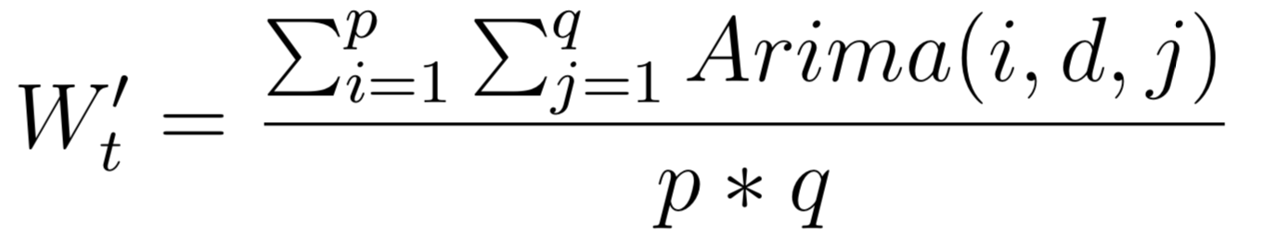
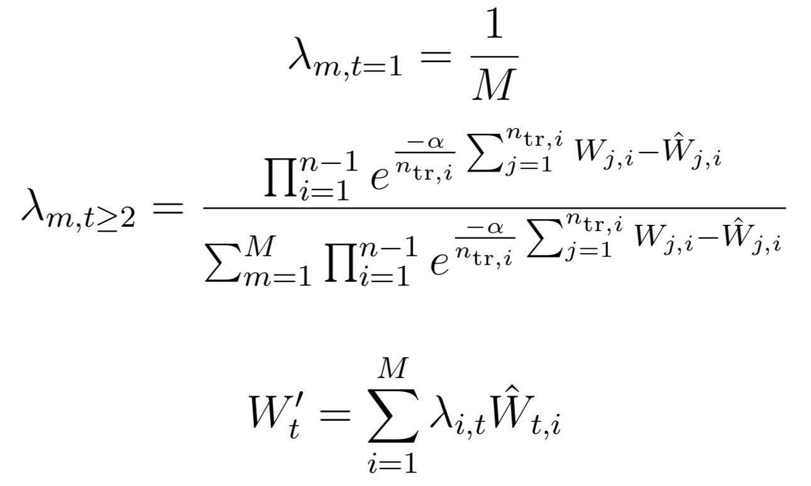
Time Series Models - ARIMA
Bayesian Information Criterion (BIC)
Pythagorean Expectation
Pythagorean Regressor (PYRIMA)
Naïve Weights
AFTER Weights
Notes:
These are the models I used.

Slide 4
MSPE
3% = 5 games
6% = 10 games
9% = 15 games
Notes:
We can see that the models perform differently for each team. Must find sweet spot. These are off-by-percentages

Slide 5
Ranked 2018

Slide 6
Raw 2018

Slide 7
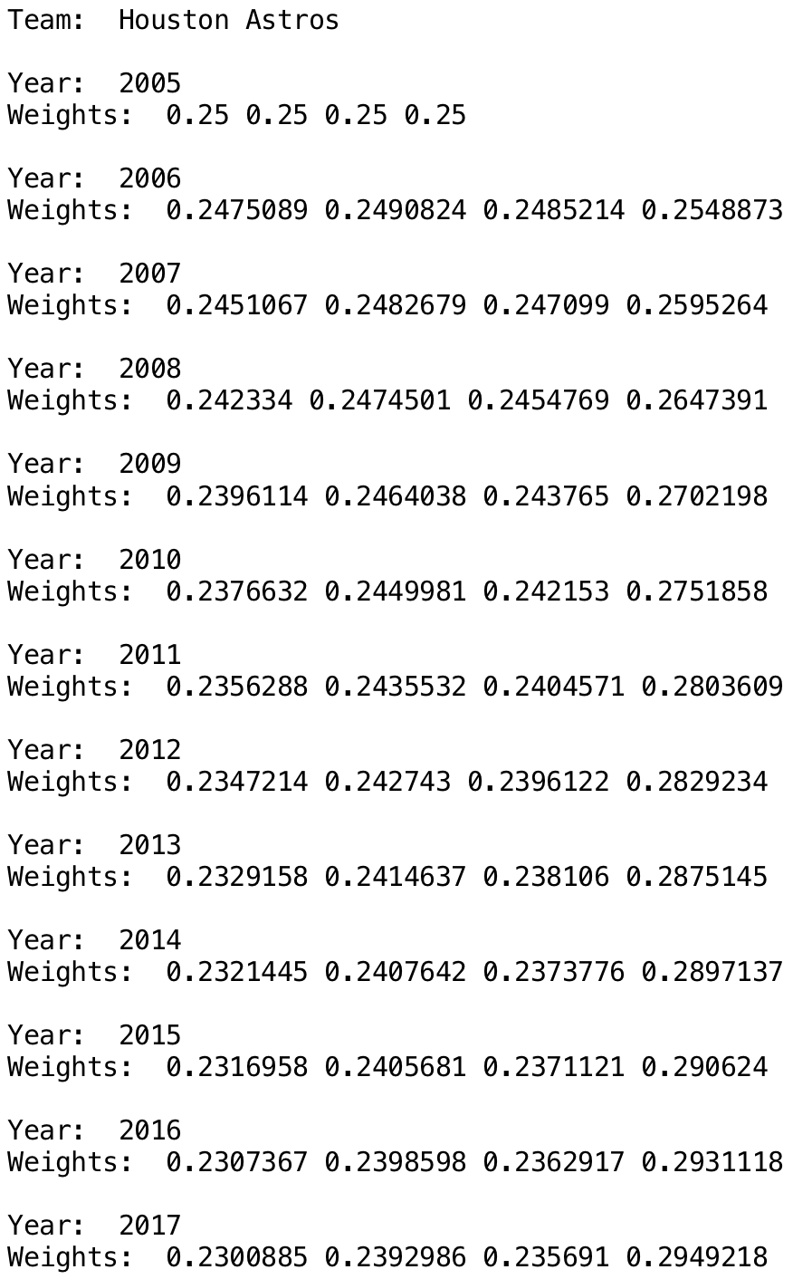
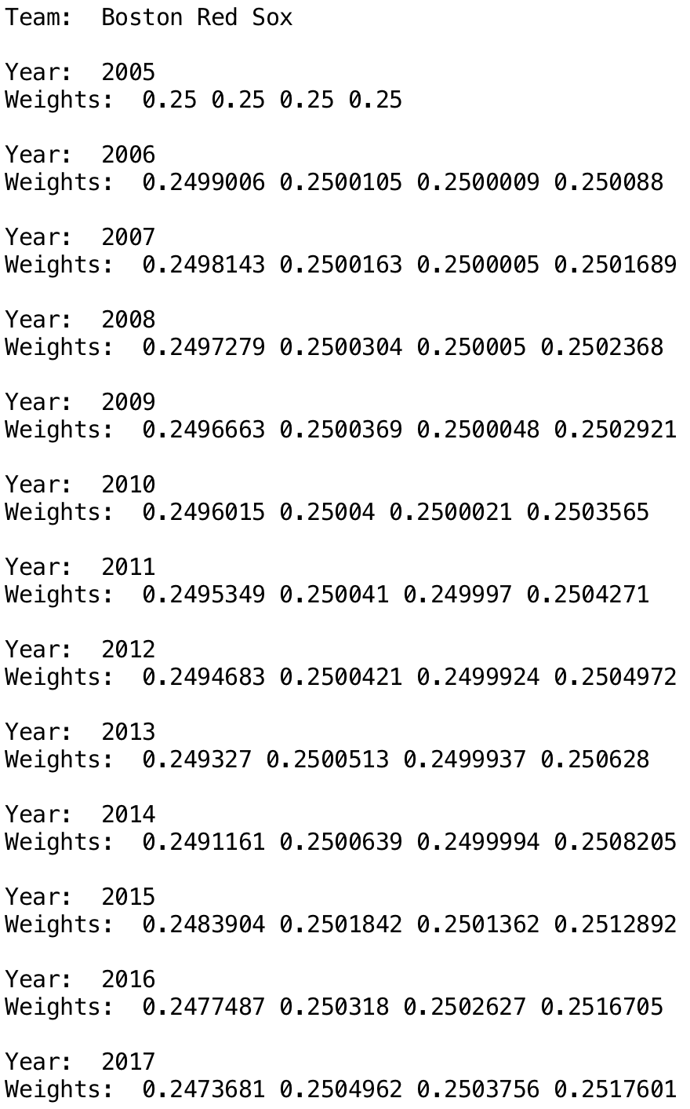
After Weights

Slide 8

Conclusion
Univariate BIC model performs the best
Select team’s record based on lowest MSPE
Each model has its own strengths
Factor in team changes to increase accuracy

